Slide 1
The Breadth of AI Applications: The Ongoing Expansion
Peter Norvig

Slide 2
Theoreticians

Slide 3
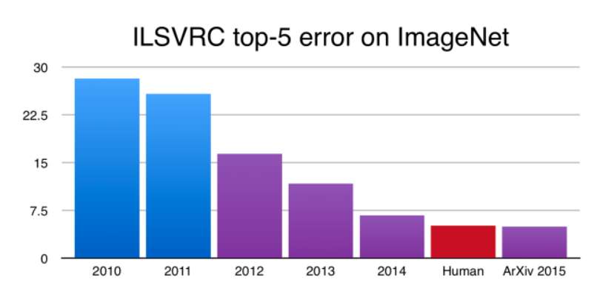
Computer Vision

Slide 4
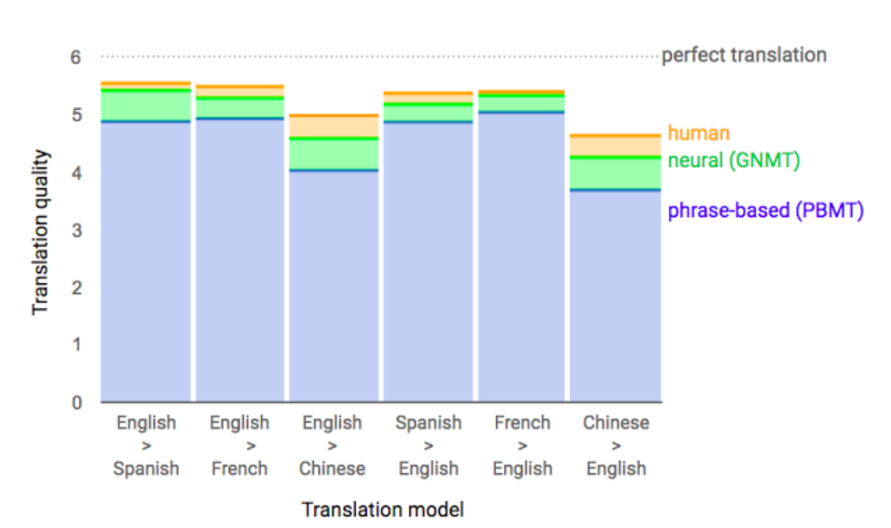
Machine Translation

Slide 5
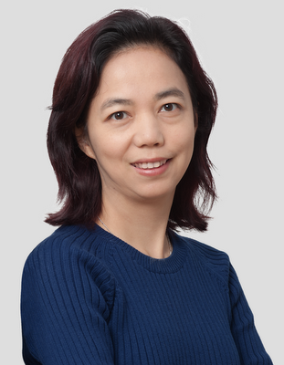
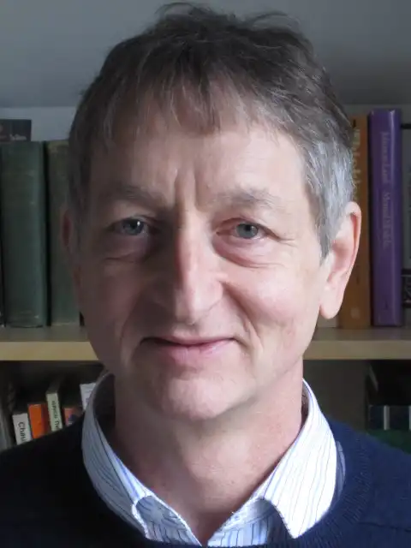
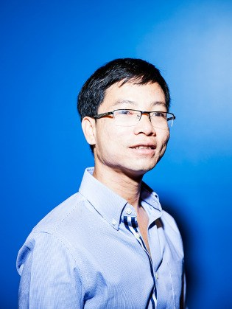
Fei-Fei Li Geoff Hinton Quoc Le

Slide 6
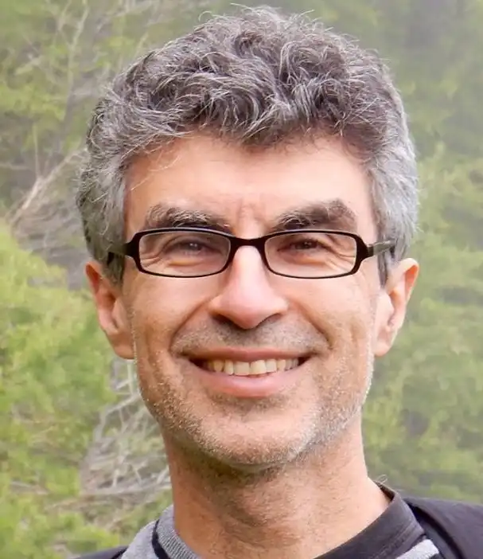
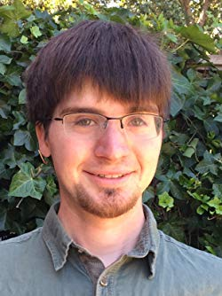
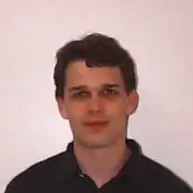
Yoshua Bengio Ian Goodfellow Sergey Ioffe
ReLU ! GANs ! Batch Normalization!

Slide 7
Practitioners

Slide 8
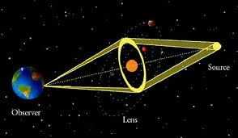
Gravitational Lensing (10 Million Times Faster)
L. P. Levasseu

Slide 9
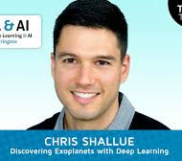
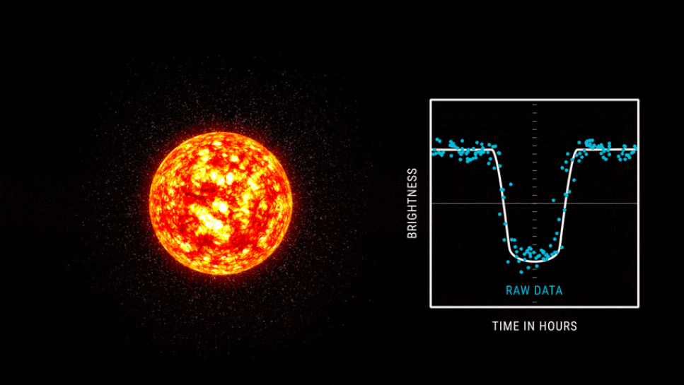
Hunting for Exoplanets
Chris Shallue

Slide 10
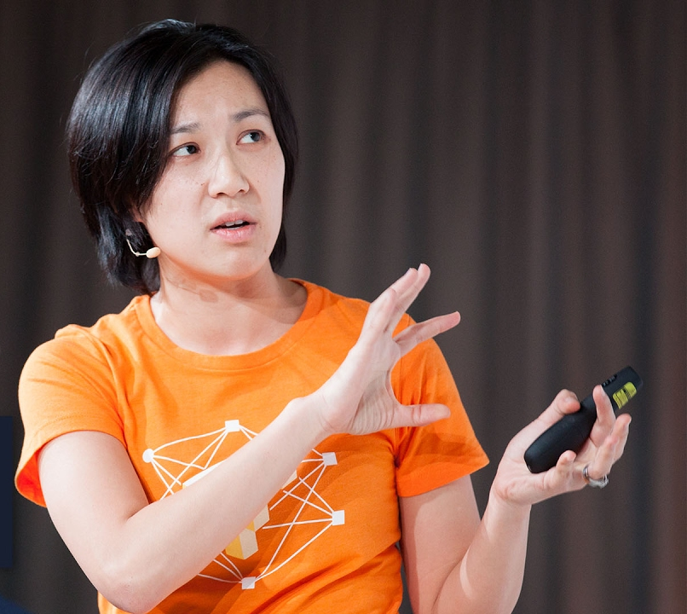
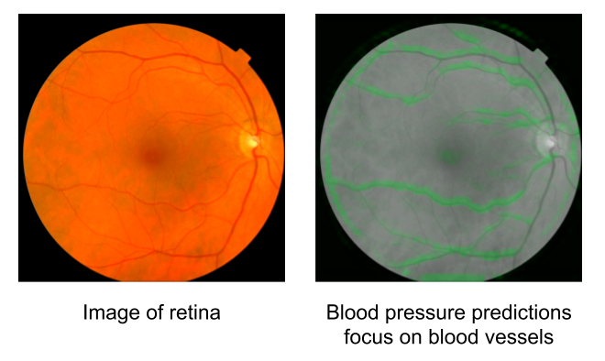
Assessing Cardiovascular Risk Factors with Computer Vision
Lily Peng
Notes:
Predict eye disease -> predict cardiovascular health

Slide 11
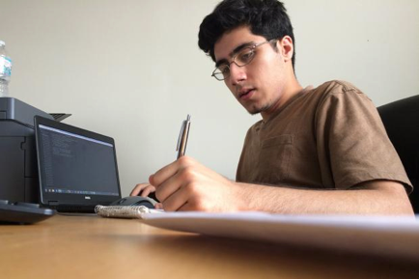
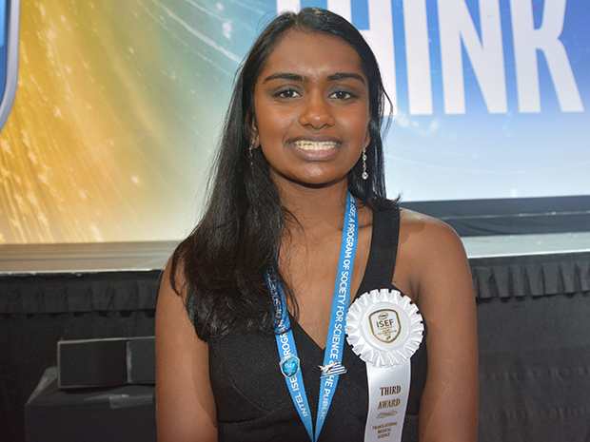
High School Students Identifying Cancer
Abu Qadar Kavya Kopparapu

Slide 12
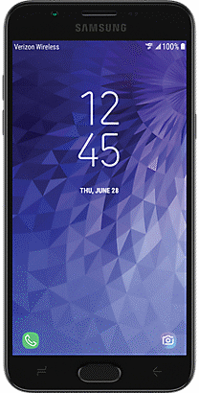
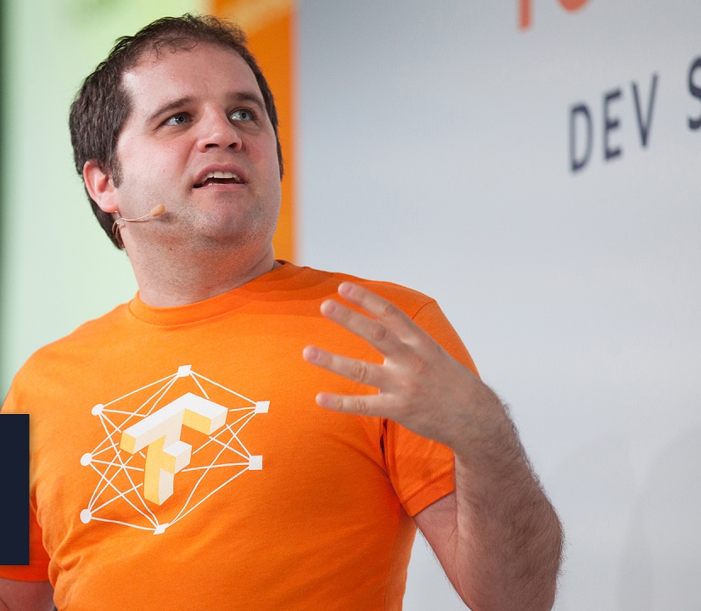
Identifying Sick Cassava Plants
Pete Warden

Slide 13
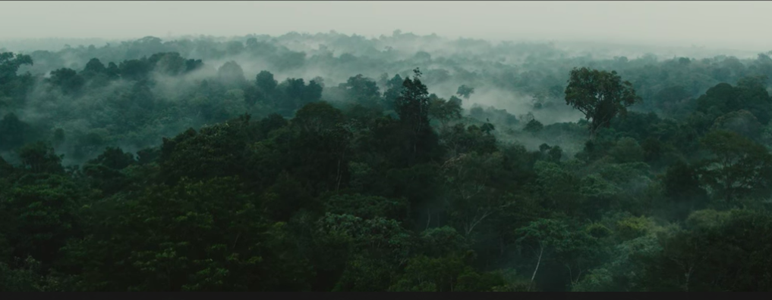
Fighting Illegal Deforestation
Topher White

Slide 14
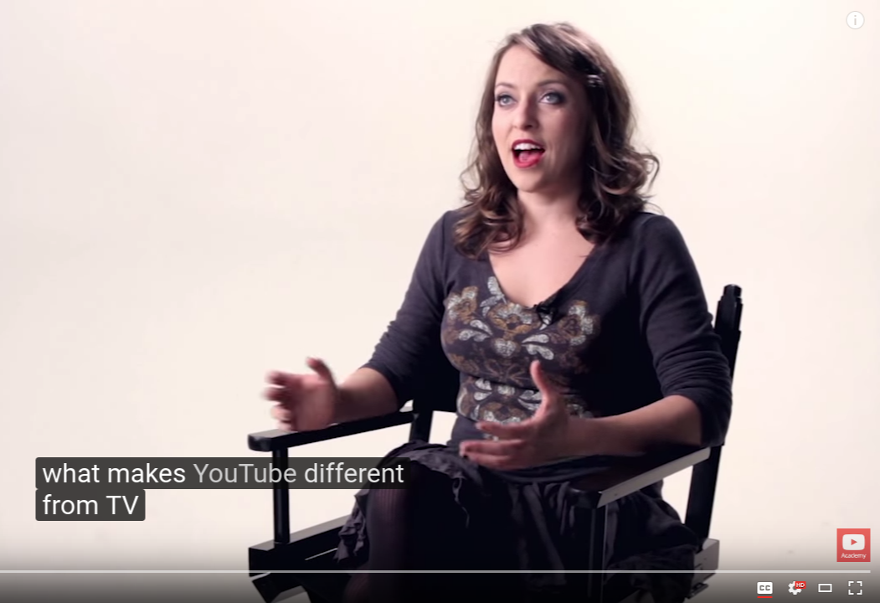
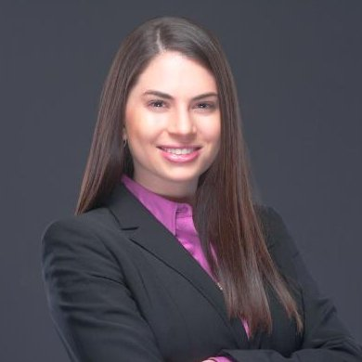
Auto-captioning Videos
Liat Kaver

Slide 15
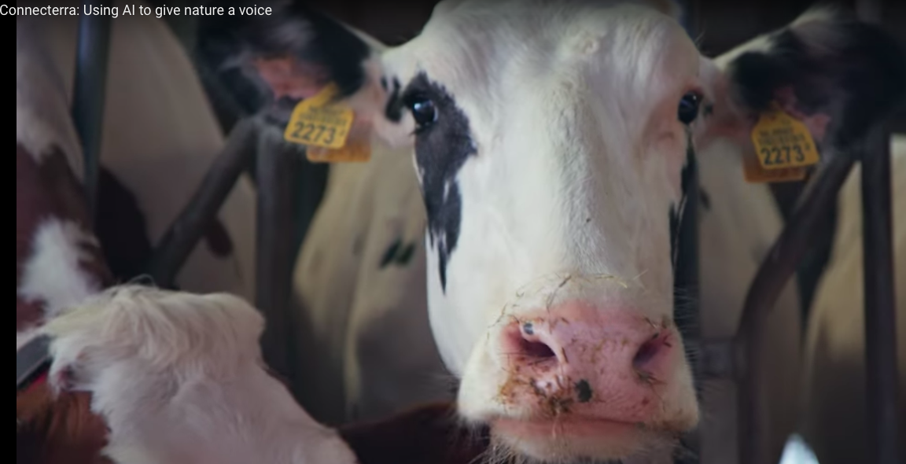
Tracking Cows
Saad Ansari

Slide 16
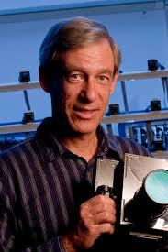
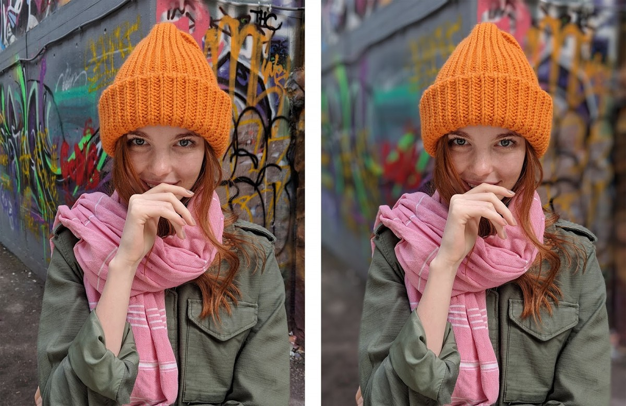
Portrait Mode
Marc Levoy

Slide 17
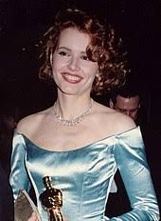
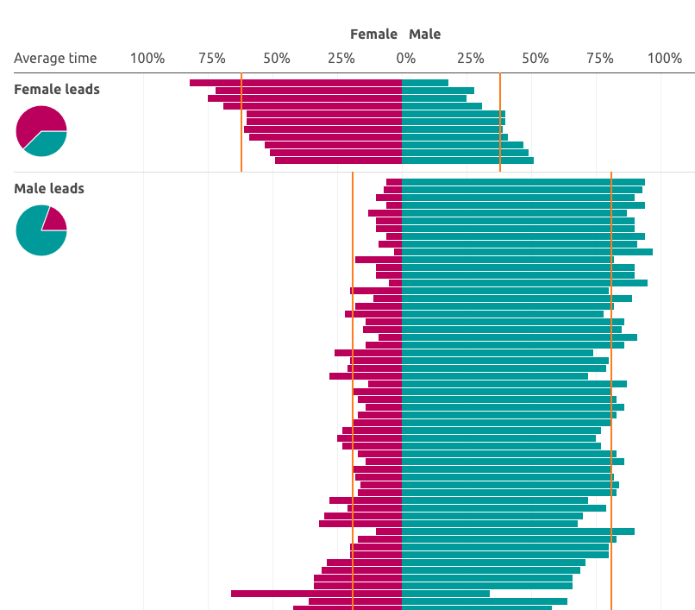
Uncovering Bias
Geena Davis

